Slide 1

ML 23/24–03 Implement the New Spatial Learning Experiment
Team : The Lazy Coders
Mandar Gokul Kale (1501517)
Anushruthpal Keshavathi Jayapal (1502741)
Lavanya Suresh (1516065)

Slide 2
OBJECTIVE
The aim of this project is optimizing the performance of the HTM (Hierarchical Temporal Memory) Spatial Pooler by fine-tuning key parameters with appropriate exit condition presenting output more effectively and addressing specific challenges encountered during the learning phase.

Slide 3
AGENDA
Introduction
HTM- Spatial Pooler
Generation of SDR
Exploring Slow Column Activation in Learning Phase
Stability Analysis
Results
Conclusion

Slide 4
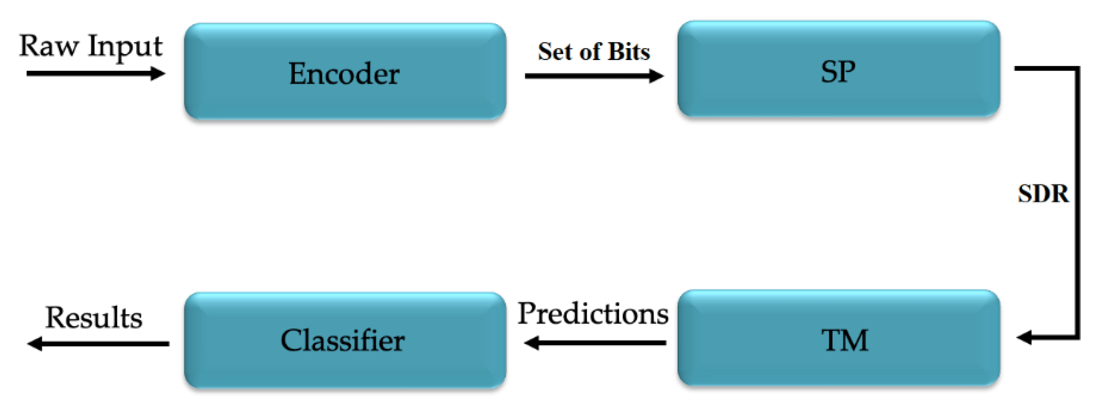
INTRODUCTION
HTM is a biologically-inspired machine learning framework designed to mimic the brain's ability to learn and recognize temporal patterns.
Fig. 1 : HTM theory

Slide 5
HTM – Spatial Pooler
The Spatial Pooler is a critical component of HTM, responsible for creating sparse distributed representations of input data.
It operates by organizing input into columns and cells, utilizing mechanisms such as inhibition and boosting to promote sparsity and enhance pattern recognition.
It has applications in a wide range of fields and contributes to the robustness and efficiency of HTM-based systems.

Slide 6
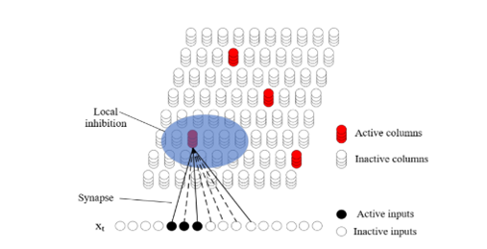
Generation of SDR
Each column in the Spatial Pooler establishes synaptic connections, known as synapses, with the input space.
The strength of these connections is represented by permanence values.
Synapses with permanence values exceeding a threshold are considered connected (solid line), while those below are potential (dotted line).
Activated columns, identified by higher permanence values compared to neighboring columns, contribute to forming the Sparse Distributed Representation (SDR) for the current input.
Fig. 2 : Spatial Pooler structure of HTM

Slide 7

Generation of SDR
1. Initialization
2. Column activation
(Here, the overlap $O_{C_{i}}$ is calculated as follows:
${O_{C}}_{i}= \left(\sum_{j=0}^{n}{e_{i}^{j}}×{\hat{s}}_{i}^{j}\right)×b_{i}$ )
3. Synaptic permanence learning

Slide 8
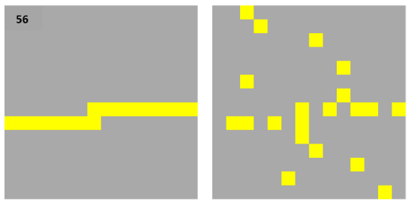
Exploring Slow Column Activation in Learning Phase
Identifying Indexing issue in ‘SetPermanences method’.
Implement ‘SetUpdatedPermanences’ method.
Use ‘inputIndexes’ for indexing.
Map ‘perms’ to ‘connectedCounts’
Better Alignment & Reduced Overlaps.
Enhanced Accuracy & Effectiveness with Improved Reliability & Performance.
Fig. 4 Representation of input vector labelled as "56"(left) and the corresponding matrix displaying connected counts(right), which results in overlaps

Slide 9
Stability Analysis
Table Table 1: Effects of MaxBoost and numOfCyclesToWaitOnChange on Stability
numOfCycles ToWaitOn Change | Max Boost | 1st Stable Cycle | Stability Fluctuations |  |  | Final Stable cycle
 |  |  | 1st unstable cycle | 2nd stable cycle | 2nd unstable cycle
50 | 5 | 308 | 345 | 395 | 484 | 534
 | 10 | 309 | 345 | - | - | 395
75 | 5 | 333 | 345 | 420 | 484 | 559
 | 10 | 334 | 345 | - | - | 420
100 | 5 | 445 | 484 | - | - | 584
 | 10 | 445 | - | - | - | 445

Slide 10
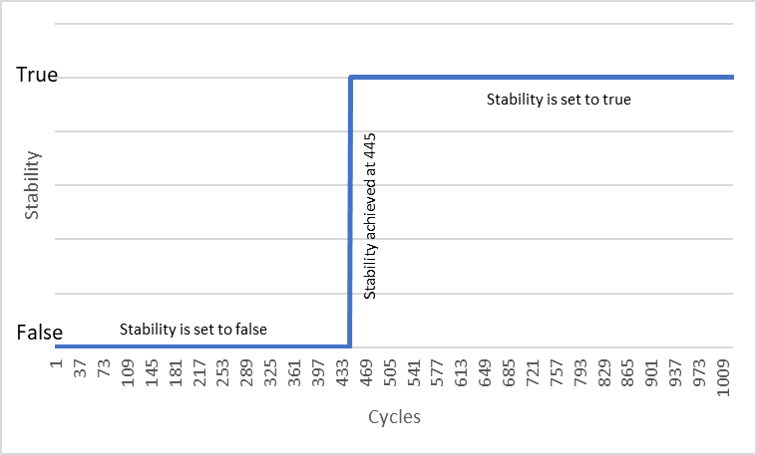
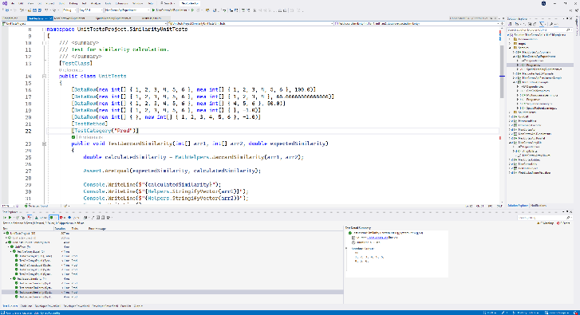
Results
Fig. 5 :Stability trends over 1000 cycles with Stable State reached at cycle 445 and constant behavior thereafter.
Fig. 6: Unit Testing for Jaccard Similarity

Slide 11
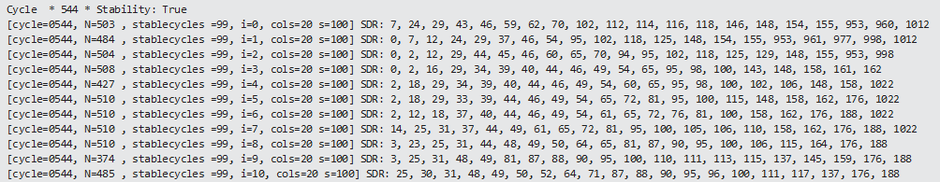
Fig 7. Output representation
Breakdown of the output represenattion:
cycle=0544: This indicates the cycle number, where the current cycle is 544.
N=503: This indicates the number of iterations during which the SDR for the input remained unchanged or stable, which is 503.
StableCycles=99: This represents the number of consecutive stable cycles leading up to the current cycle, which is 99.
i=0: This indicates the input and iteration number within the current cycle, which is 0.
cols=20: This signifies the total number of mini-columns that are active in the current iteration.
s=100: This represents the similarity between the SDR of the current cycle and the SDR of the previous cycle for the input. A value of 100 indicates a perfect match between the two representations, while lower values indicate less similarity.
SDR: 7, 24, 29, ... 1012: This is the Sparse Distributed Representation (SDR) generated by the Spatial Pooler for the current input value. The numbers represent the indices of the active mini-columns in the SDR.

Slide 12
Conclusion
The new Spatial Learning experiment is an improved version of the Spatial Pattern Learning Experiment.
It replaces the old 1000-cycle methodology with a new approach that terminates once stability is confirmed and sustained for an additional 100 cycles, saving computational power and time.
Addressed slow activation of datasets during the learning phase by changing indexing, improving system effectiveness.
Implemented Jaccard similarity to compare Sparse Distributed Representations (SDRs), providing a nuanced understanding of similarity.
The output has been demonstrated appropriately showcasing relevant parameters.
Fine-tuned essential parameters to ensure system stability without disturbance in future data.

Slide 13
THANK YOU

